Slide 1




Flexible keyboard
Team Members:
Kirthi Vignan Reddy
Anvesh Reddy
Prof : Aftab Hussian
TA : Mohee Dutta Gupta

Slide 2
Why flexible keyboard?
Normal Keyboards are bulky and difficult to carry around
Making it flexible/rollable resolves the problem
Having bluetooth enables us to connect to more devices wirelessly.

Slide 3
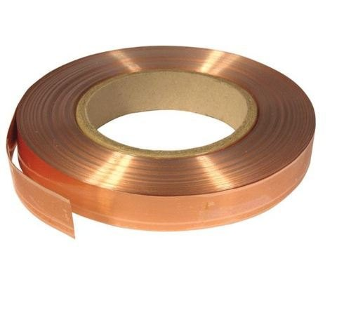
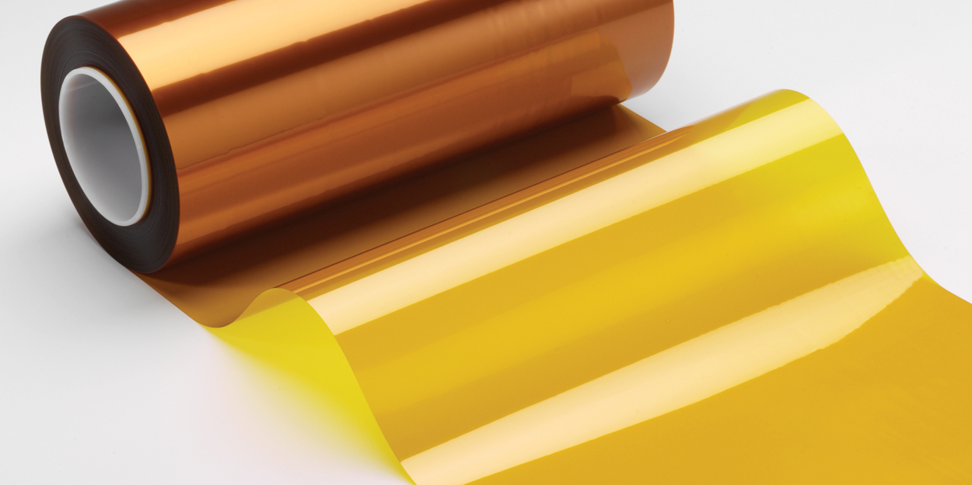
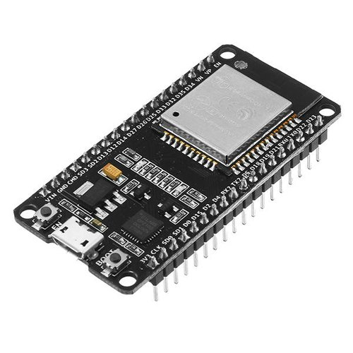
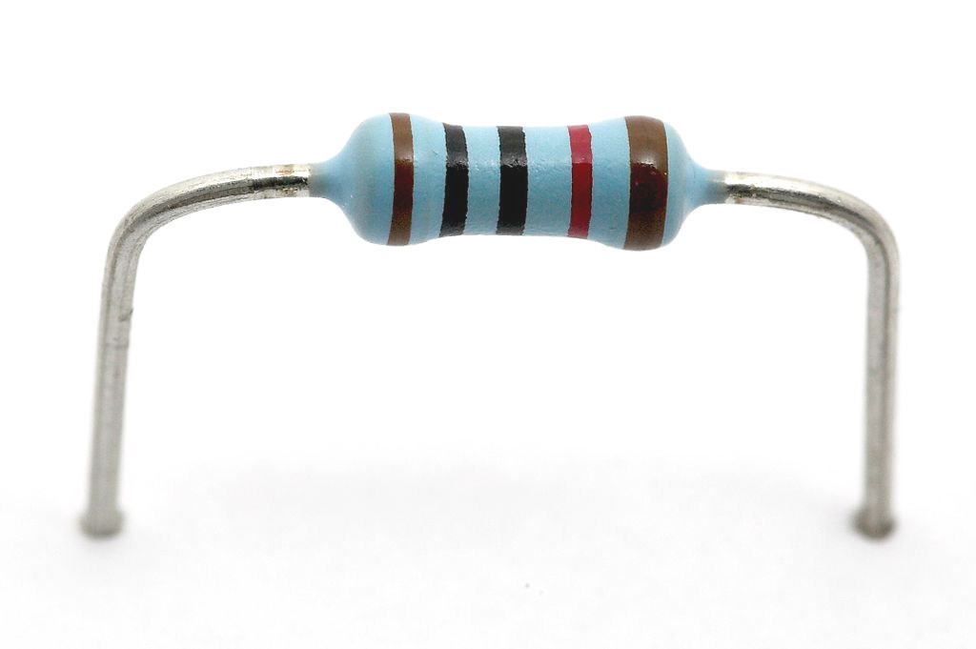
COMPONENTS USED
Dupont Kapton polyimide film
Copper tape
Resistors
ESP32

Slide 4
Working
We use Kapton as base because it is flexible and acts as an insulator
Copper tape is used as conductive lines
Keys are made into comb structure using copper tape
A 1M resistance is placed in series with the comb structure

Slide 5
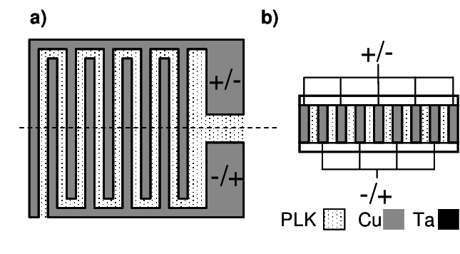
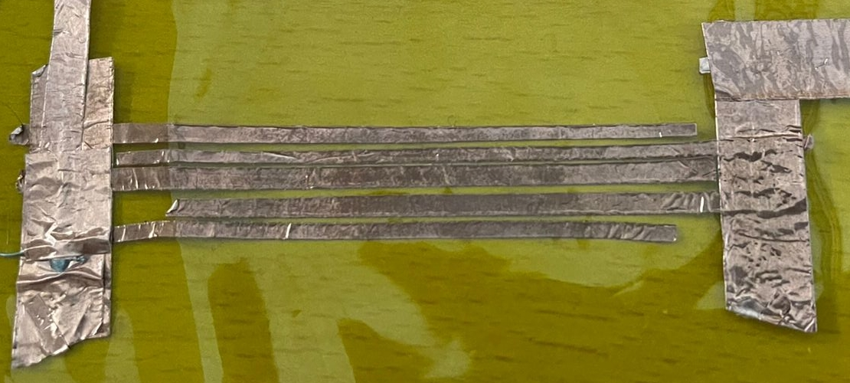
Comb structure
Comb Structure is used to increase the Surface area
Due to this Comb structure even if the finger is not touched completely the tap can be registered

Slide 6
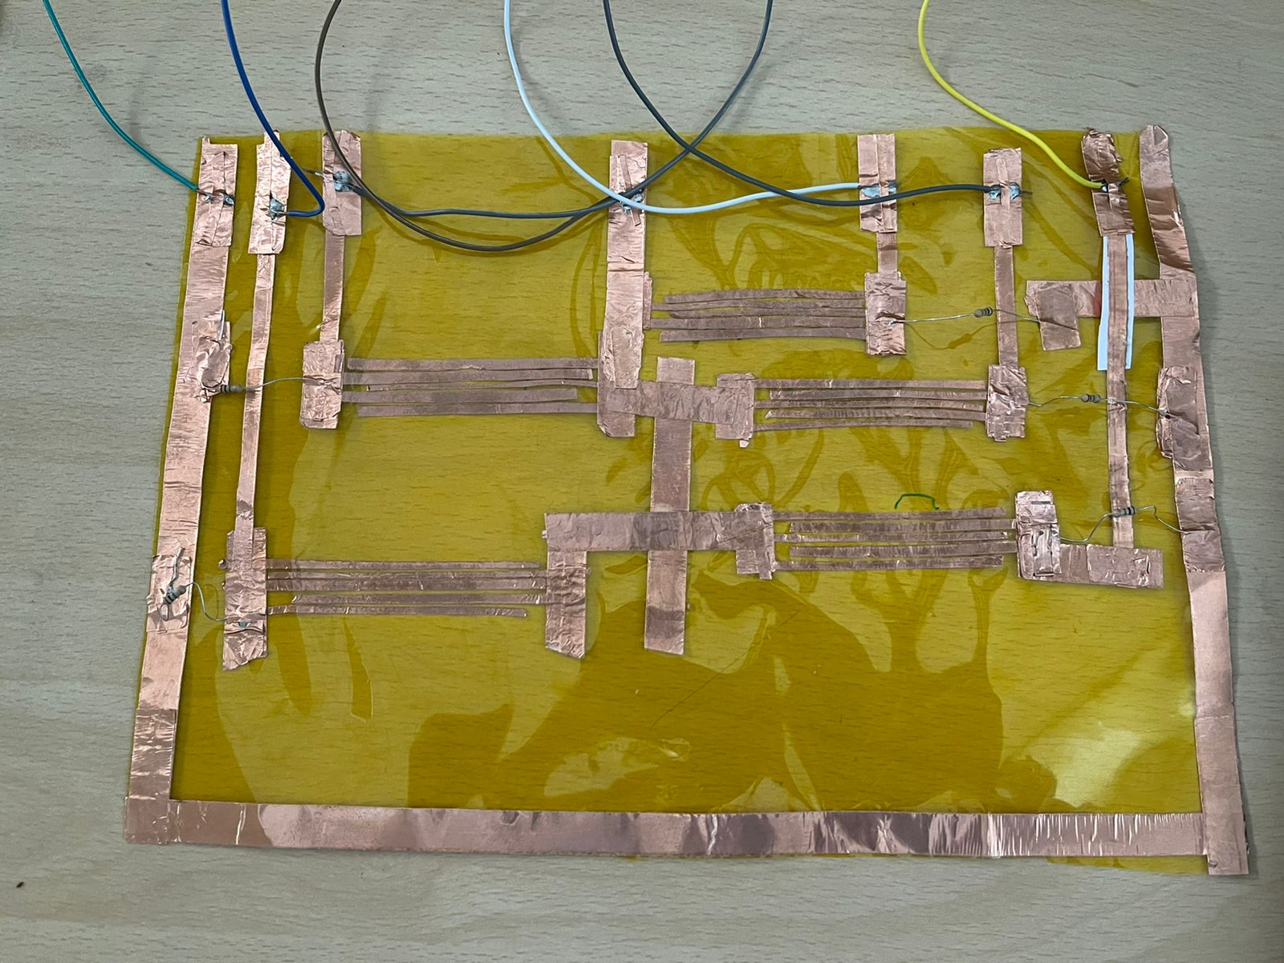
We put 3.3V across a key (comb structure+resistance)
When we tap the comb structure, we short the copper lines in the comb resulting in the complete voltage being across the 1M resistance.
By measuring this change in voltage across this resistor, we can identify the tap on a key.
To represent a simplistic form of keyboard, we are using the bit combinations of 5 keys

Slide 7
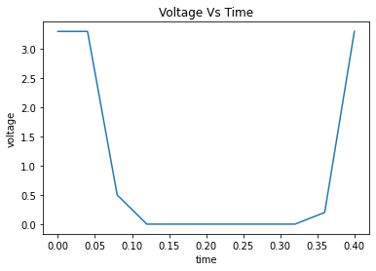
Working of software
Each key when pressed is bit 1, when not pressed is bit 0
These 5 keys thus gives 5 bits which can be used to represent 2^5 = 32 characters
We encode this in the software and assign a decimal value for each character
Based on the key combinations of these 5 keys, we get a decimal value which refers to a particular character.
The character is then printed on the device connected to ESP32's Bluetooth.

Slide 8
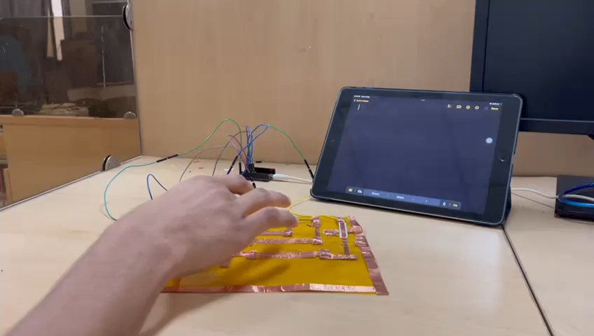

Slide 9

Thank you

